Slide 1
The Seat at the Table (III): The Church Shares
Acts 4:32-35 (HCSB)

Slide 2
Church shares when it is UNITED (v. 32a)

Slide 3
Acts 4:32-34
32 Now the large group of those who believed were of one heart and mind, and no one said that any of his possessions was his own, but instead they held everything in common.
33 And the apostles were giving testimony with great power to the resurrection of the Lord Jesus, and great grace was on all of them.

Slide 4
One Heart and Mind
John 17:11 - united to Christ and Father, as Christ and Father are One
Phil. 1:27 - standing firm in one spirit, with one mind striving for gospel faith
Phil. 2:2 - being of same mind, same love, in full accord
1 Corinthians 1:10 - by Christ’s name, agree, being united in same judgment
1 Peter 3:8 - unity in mind, sympathy, brotherly love, tender heart, humble mind
Jeremiah 32:39 - God gives one heart, to fear Him, for our own good
Ezekiel 11:19-20 - God removes heart of stone and gives new heart

Slide 5
II. Church shares when it lives as a FAMILY (v.32b)
Commonality
Voluntary
Mutual
One message and testimony
Generosity

Slide 6
How To Build Generosity into Your Life
Be grateful
Put people first
Don’t allow greed to control you
Regard money as a resource
Develop habit of giving

Slide 7
III. Church shares when burdened for COMMUNITY (v.34-35)

Slide 8
Acts 4:34-37
34 For there was not a needy person among them, because all those who owned lands or houses sold them, brought the proceeds of the things that were sold,
35 and laid them at the apostles’ feet. This was then distributed for each person’s basic needs
36 Joseph, a Levite and a Cypriot by birth, the one the apostles called Barnabas, which is translated Son of Encouragement, 37 sold a field he owned, brought the money, and laid it at the apostles’ feet.

Slide 9
III. Church shares when burdened for COMMUNITY (v.34-35)
Responsibility for one another
Entrusted proceeds to the church leadership
Church leadership continually gives away
Who are the needy around us?

Slide 10


Slide 11
Now What?
Look around and join where God is at work
Love your church family by being transparent
Love loud by serving our city community
Love loud by sharing the resurrected Christ
Love loud by reaching the unreached
Love loud by supporting SBC Cooperative Program

Slide 12
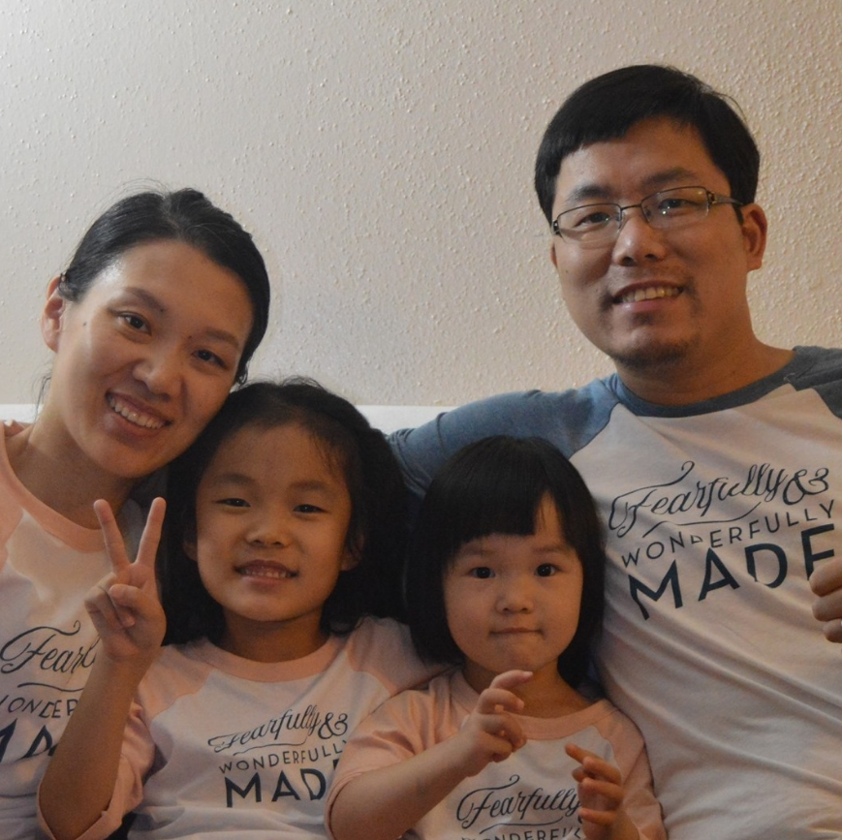
Joseph Sheng
BSM
Texas A & M
Thanks to your gifts through the Cooperative Program

Slide 13
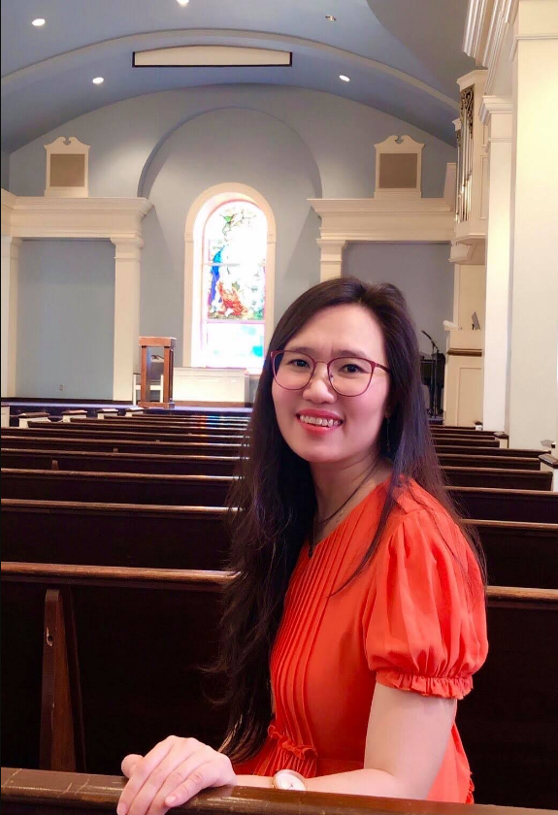
Xuehua Dong
BSM
UH Main
Thanks to your gifts through the Cooperative Program

Slide 14
https://www.sbc.net/missions/the-cooperative-program/
https://www.texasbaptists.org/cooperative-program
https://whatiscp.com/

Slide 15
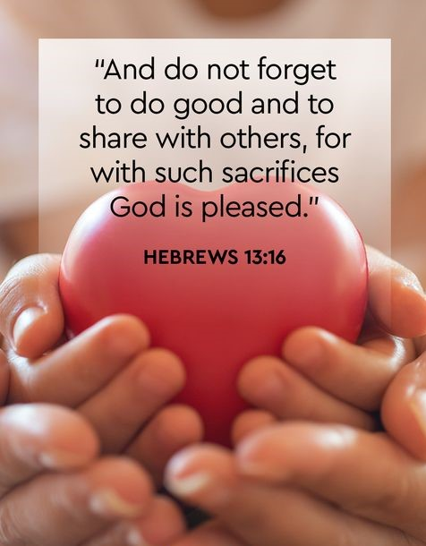

Slide 16
Will you ask Him to give you a generous heart?
Will you Love Loud of CBC and non-CBC?
May Christ use CBC for His glory in this City

