Slide 1
The Seat at the Table (II): Leaders’ Courage
Acts 4:1-12 (HCSB)

Slide 2
Acts 4:1-4
Now as they were speaking to the people, the priests, the commander of the temple police, and the Sadducees confronted them,
2 because they were provoked that they were teaching the people and proclaiming the resurrection from the dead, using Jesus as the example.
3 So they seized them and put them in custody until the next day, since it was already evening.
4 But many of those who heard the message believed, and the number of the men came to about 5,000.

Slide 3
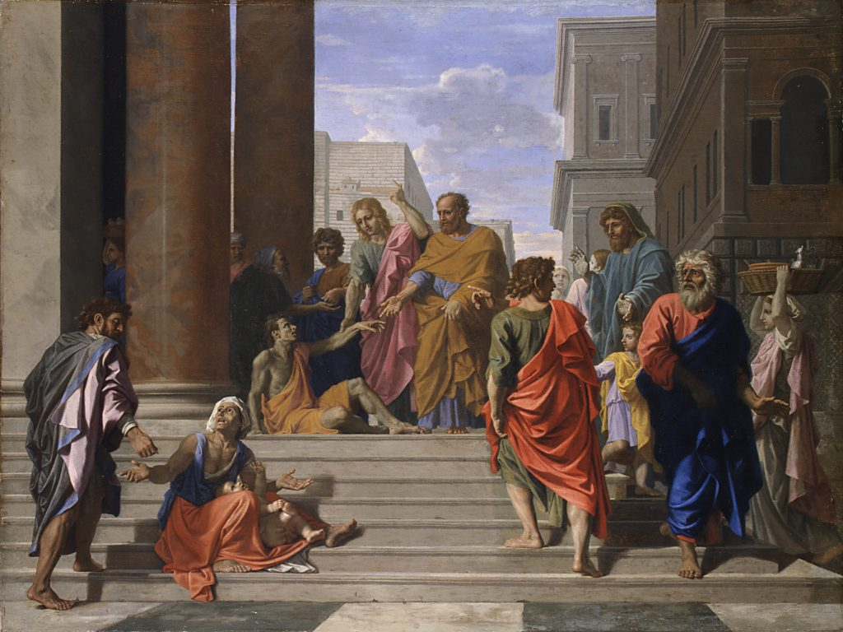

Slide 4
Acts 4:5-10
5 The next day, their rulers, elders, and scribes assembled in Jerusalem
6 with Annas the high priest, Caiaphas, John and Alexander, and all the members of the high-priestly family.
7 After they had Peter and John stand before them, they asked the question: “By what power or in what name have you done this?”
8 Then Peter was filled with the Holy Spirit and said to them, “Rulers of the people and elders:
9 If we are being examined today about a good deed done to a disabled man—by what means he was healed—

Slide 5
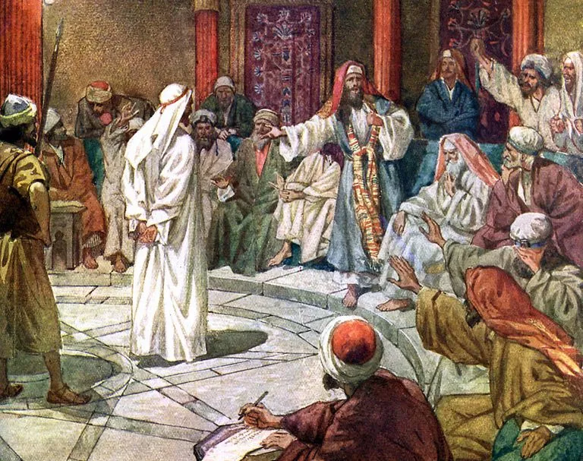

Slide 6
Courageous Leaders Are Filled with God’s Spirit (v.8)
Filled
Πλήθω plḗthō
expresses totality, and implies full quantity ("up to the max")
that which is complete in itself because of plentitude
Shows that it was a repeatable experience

Slide 7
Courageous Leaders Are Filled with God’s Spirit
Being filled with the Holy Spirit leads to boldness to stand firm in persecution
Being filled with the Holy Spirit leads to conviction that only Christ saves
Being filled with the Holy Spirit motivates to keep on verbally sharing gospel
Being filled with the Holy Spirit leads to a joyful and purposeful Christian life
Being filled with the Holy Spirit helps church on meeting the needs of the community
Being filled with the Holy Spirit makes church a faithful witness and grows the church

Slide 8
Acts 4:10-12
10 let it be known to all of you and to all the people of Israel, that by the name of Jesus Christ the Nazarene—whom you crucified and whom God raised from the dead—by Him this man is standing here before you healthy.
11 This Jesus is
the stone rejected by you builders,
which has become the cornerstone.
12 There is salvation in no one else, for there is no other name under heaven given to people, and we must be saved by it.”

Slide 9
II. Courageous Leaders Preach Exclusivity of Christ (v. 12)
No one in the world can save the soul except the risen Christ (Rom. 3:21-31)
God ordained this plan of salvation (Gen. 3:15, Is.8:14-15, 52:13-53;12)
People must hear the gospel first to be saved (Rom. 10:17)
Gospel = Christ’s cross-work and resurrection from dead (1 Cor. 15:1-3)
Gospel message must be clearly communicated and a response offered
People choose to believe in the name of Christ (Jn. 3:16-18)
Religion, good works, own effort, cannot save the person’s soul

Slide 10
Application - Church Leaders Need Courage To...
Seek God’s Truth
Change for Gospel’s sake
Express Convictions
Overcome Obstacles
Learn and Grow
Servant-Lead Others

Slide 11
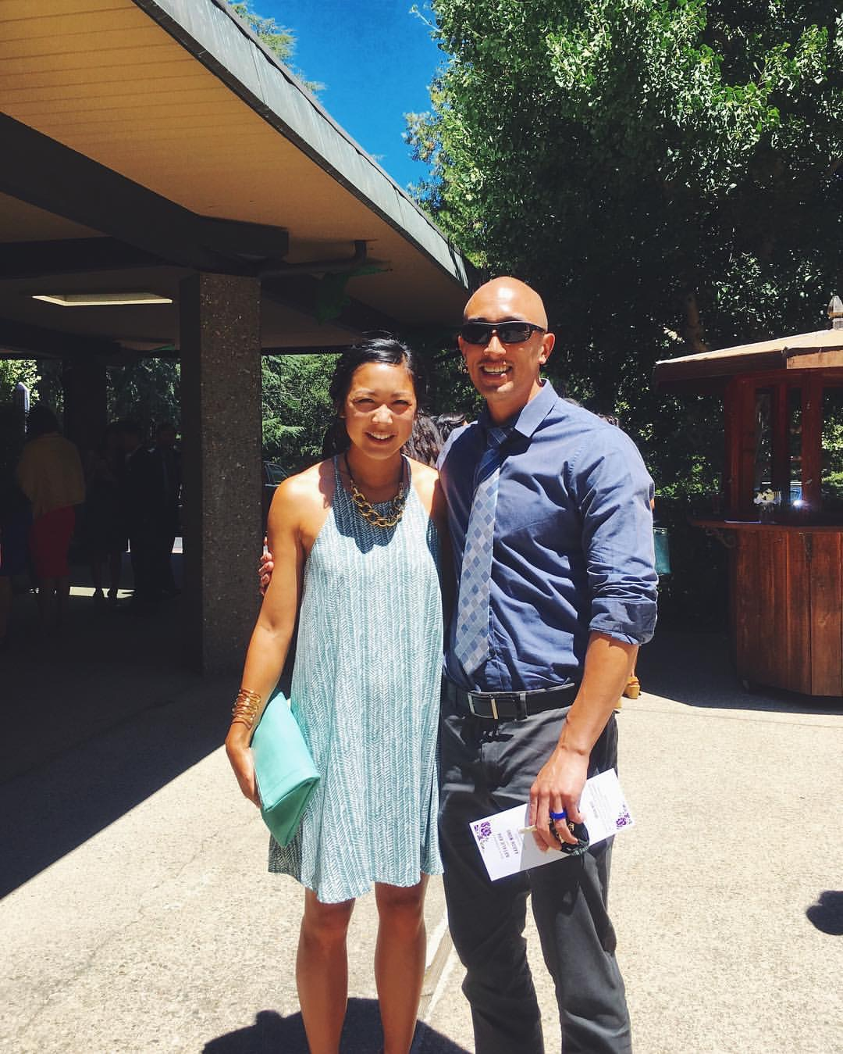
Tandon v. Newsom, 4/9/21
Associate Pastor Jeremy Wong
Orchard Community Church, CA
SCOTUS overturns 9th Circuit Court decision banning in-home religious gatherings of more than 3 households
Amy Howe, Divided court blocks California’s COVID-related restrictions on in-home religious gatherings, SCOTUSblog
https://www.scotusblog.com/2021/04/divided-court-blocks-californias-covid-related-restrictions-on-in-home-religious-gatherings/

Slide 12
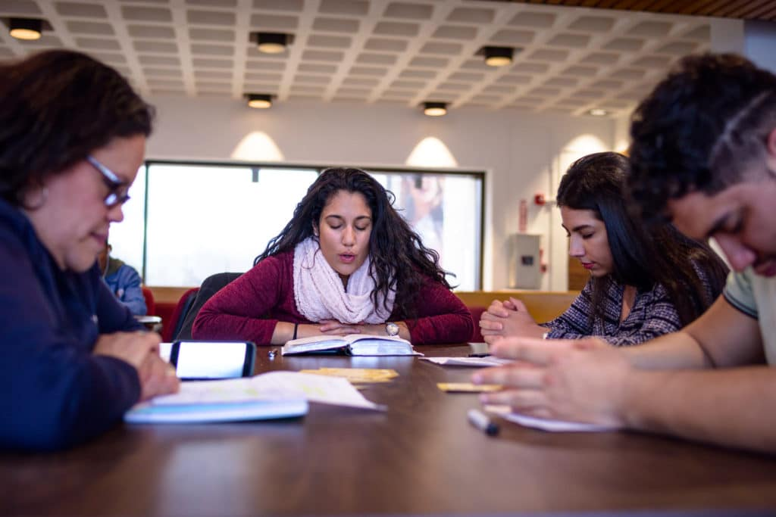
InterVarsity Christian Fellowship v.
Wayne State University, 4/5/21
Federal Court protects InterVarsity decision to require its leaders to share their faith, holds WSU liable
Becket Fund for Religious Liberty, April 5 2021
https://www.becketlaw.org/media/court-wayne-states-actions-obviously-odious-to-the-constitution/

Slide 13
“One Person with Courage is a Majority”
Will you ask Him to fill you with His Spirit?
Obey Christ and watch Him accomplish mighty work

