Slide 1
Chinese Baptist Church
Child Protection Policy
Revised April 2016

Slide 2
Objectives
Understand the philosophy and foundation of Gospel-centered child care
Understand and implement CBC’s Child Protection Policy
Equip workers at CBC to be mandated reporters

Slide 3
Mission
The children’s & youth ministry of Chinese Baptist Church exists to glorify God by:
Supporting and encouraging parents who are primarily responsible for teaching biblical truths to their children (Ephesians 6:4)
Making the whole counsel of Scripture known to children with special emphasis on the Gospel (Deuteronomy 6:6-9; Romans 1:16-17)
Praying for the children and relying on the Holy Spirit to regenerate their hearts through the faithful teaching of His Word (Romans 10:17; Ephesians 2:4-10)
Living faithfully before the children and modeling for them how Christians are called to respond to God, interact with each other, and with the world around us (Matthew 5:16;1 Corinthians 11:1)

Slide 4
Caregiver Expectations
All children’s & youth ministry volunteers share a particular responsibility for:
Loving the children as Christ loves them
Setting an example of proper Christian conduct in the way we live our lives
Ministering to the children
Understanding that the care of children is not a right, but a privilege; and this privilege embodies responsibilities to God for ministering to and caring for the children

Slide 5
Child Protection Policy
Our first concern is that the children be safe while they are in our care.
To this end we:
Screen all children’s ministry volunteers & require training for all children’s ministry volunteers
Employ scheduling procedures and caregiver/child ratios that optimize safety
Equip each area of the church with a first aid kit
Educate our volunteers about recognizing child abuse and encourage them to report any known or suspected abuse to church officials and/or to appropriate governmental authorities consistent with applicable laws

Slide 6
Protecting the Children
Before They Arrive
Ensuring a safe environment begins long before Sunday morning. Every applicant who wishes to serve in children’s ministry is required to go through a screening process and attend childcare training.

Slide 7
Screening Procedure
All caregivers must be members in good standing of CBC for at least 6 months.
All caregivers must be eighteen years of age or older. Youth who are at least eleven years of age are welcome to assist (subject to the approval and direction of the Director of Children’s Ministry), but they are always in addition to the adult caregivers.
All caregivers must have completed childcare training.
All caregivers must have completed the caregiver application and been recommended by or in consultation with the pastor responsible for children’s ministry.

Slide 8
Protecting the Children As They Arrive and Depart
Arrival and Departure Times
Caregivers should be ready to accept children 30 minutes prior to the start of any session, so that parents have enough time to transition their children before the session begins.
Parents are encouraged to pick up their children immediately after the conclusion of the session. In the event that a child is not picked up within 15 minutes of the end of the session, caregivers will ask the Supervisor of Childcare to locate the parents.

Slide 9
Signing a Child in to Children’s Ministry
Any parent who would like his/her child to participate in a children’s ministry program will sign the child in to the appropriate classroom, nursery, or activity when he/she arrives, granting permission for the child to participate in that CBC event or program.
This will authorize CBC to secure medical services for the child in the event of accident or injury if the parents or legal guardians are unavailable. The parent should also use this opportunity to note any allergies or special needs the child may have.

Slide 10
Protecting the Children While They Are In Our Care
Two Caregiver Rule
At least two qualified, adult caregivers must be present in each classroom at all times. We consider adults to be age eighteen and older. Youth that are at least eleven years of age are welcome to assist (subject to the approval and direction of the Children’s Ministry Administrator), but they are always in addition to and supervised by the two adults.

Slide 11
Protecting the Children While They Are In Our Care
Child-to-Caregiver Ratios
In addition to always having two caregivers present, the following ratios are maintained during
the regularly scheduled weekly meetings of the church:
Children ages 0-2 One adult for every two-four children, depending on their ages
Children ages 3-5 One adult for every eight children
Children ages 6-12 One adult for every twelve children

Slide 12
Appropriate Discipline
All children’s ministry volunteers are responsible for providing a loving, respectful, and orderly atmosphere in which children can learn, play, and interact with others. This atmosphere should be maintained by preparing beforehand, proactively directing children towards acceptable activities, verbally encouraging positive behavior, and, when necessary, correcting or redirecting inappropriate behavior.
Acceptable means of redirecting inappropriate behavior include correcting the child verbally, withholding a certain privilege or activity for a brief time, or separating a child from the group for a brief time (particularly if his behavior is endangering or upsetting other children).

Slide 13
Appropriate Discipline
Children’s ministry volunteers and staff members should never yell, spank, or hit a child. If behavior is uncontrollable or the child does not respond to the discipline measures above, ask the supervisor to call the parents.
For further information regarding discipline please speak with the Director of Children’s
Ministry.

Slide 14
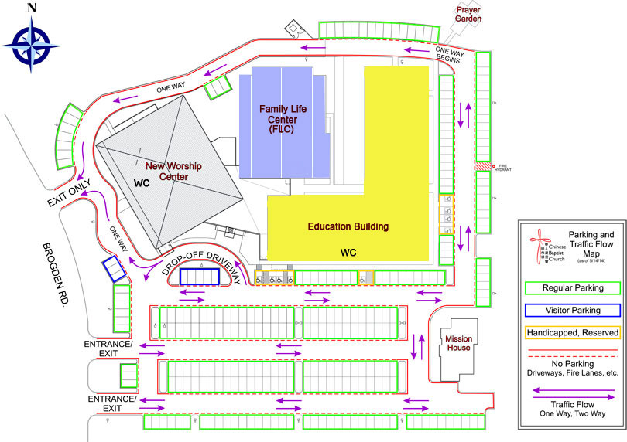
Campus Map

Slide 15
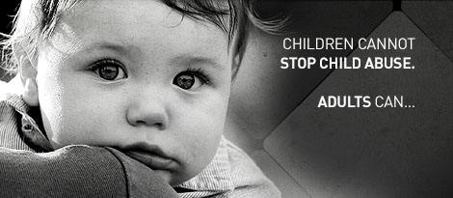
Did you know?
A report of child abuse is made every ten seconds
More than five children die every day as a result of child abuse.
Approximately 80% of children that die from abuse are under the age of 4.
More than 90% of juvenile sexual abuse victims know their perpetrator in some way.
About 30% of abused and neglected children will later abuse their own children, continuing the horrible cycle of abuse.
About 80% of 21 year olds that were abused as children met criteria for at least one psychological disorder.
14% of all men in prison in the USA were abused as children.
36% of all women in prison were abused as children.

Slide 16
3 Ways to Report Abuse @ CBC
1-800-252-5400 - Call our Abuse Hotline toll-free 24 hours a day, 7 days a week, nationwide.
TxAbuseHotline.org - Report with our secure website and get a response within 24 hours.
Report the suspected abuse to the ministry leader or Pastor of the Church.

Slide 17
